Slide 1
The World of Antique Buttons
Collecting and Enjoying Them
Notes:
Have first slide up and ready before audience arrives.
Begin with welcome and speaker introduction.
Set expectations: presentation length is about [45] minutes and preference for how you want to handle questions, etc.
Advance.

Slide 2
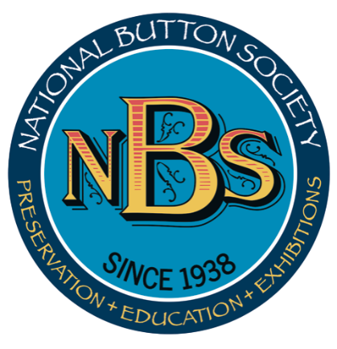
Brought to you by the National Button Society
nationalbuttonsociety.org
Notes:
Acknowledge the NBS and point out website.
Advance.

Slide 3
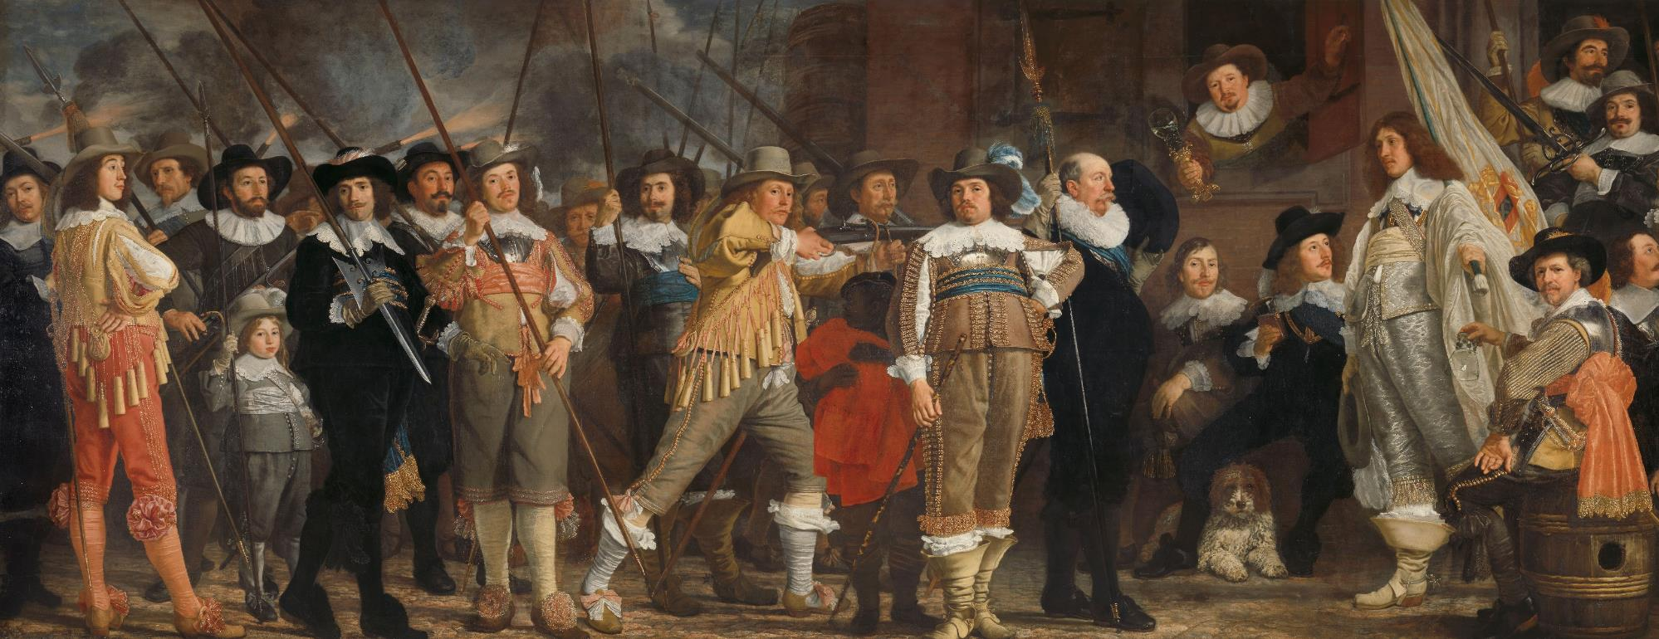
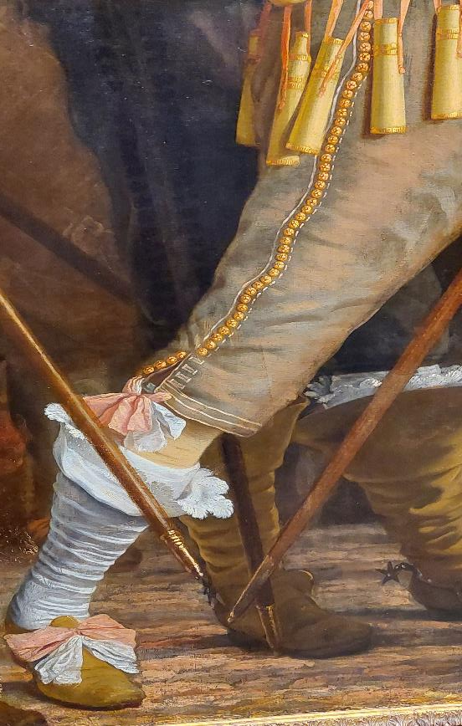
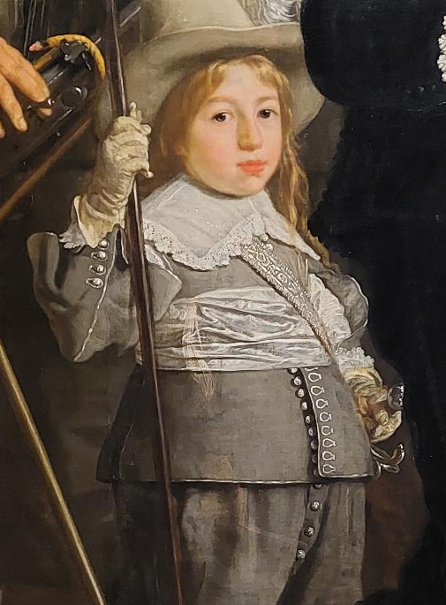
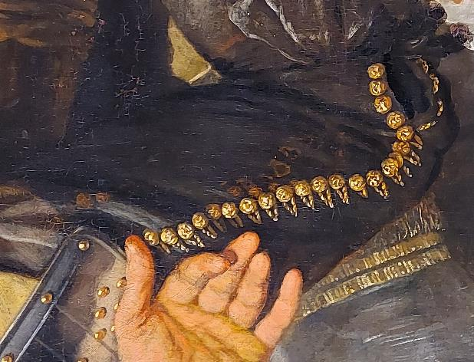
Militia Company of District VIII under the Command of Captain Roelof Bicker, Bartholomeus van der Helst, c. 1640 - c. 1643. Rijksmuseum, Amsterdam
182 buttons!
Notes:
“This painting is a wonderful example from the Dutch Golden Age that hangs in the Rijksmuseum in Amsterdam. What are some elements that immediately jump out to you?”
(Militia Company of District VIII under the command of Captain Roelof Bicker by Bartholomeus van der Helst, 1640–1643.)
Allow time for audience to throw out responses. Eventually someone has to throw out buttons.
“Yes!” Advance.
“Here are some details of the buttons.” Advance two more times allowing a few seconds between for folks to have a good look.
“Buttons of long ago were worn mostly by men, while women’s clothing was mostly secured by laces. Men’s clothing was laden with buttons—as you can see in this example. They were used to fasten breeches, waistcoats (vests), sleeves, and coats.” Advance.
“In total, there are 182 buttons in this painting. Painting and sculpture record button use through the ages but are often overlooked.” Advance.

Slide 4
Why collect them?
“… in their collecting they represent
our ever-present desire to find
the extraordinary in
the commonplace.”
Diana Epstein and Millicent Safro, authors of Buttons
Notes:
“Buttons are so common and disregarded that collectors are often asked why they collect them. Here’s one reason. But reasons are many. A love of history, art, craft, miniatures, or costume design are other reasons. Some collectors found their way to buttons from an old tin of buttons they found or inherited and were curious about them.” Advance.

Slide 5
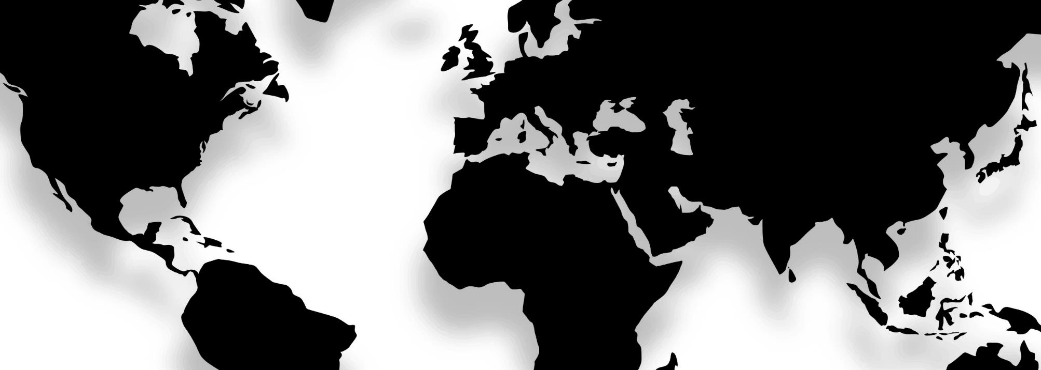
Button origins
Denmark
Netherlands
Russia
Germany
Czech Republic
England
France
Austria
Hungary
Italy
United States
Spain
China
Turkey
Iran
Morocco
Japan
Egypt
India
Notes:
“We don’t think much of buttons unless one’s lost. And no one cries over a lost button. Over 60% of the world's button supply comes from a single city in China (Qiaotou).
But over the centuries, buttons have been made all over the world. And they were made by the greatest craftsmen of their time displayed as symbols of wealth, position, and self-expression. They were considered the finest jewelry and worn almost exclusively by men. Great care was taken to make sure these buttons were NOT lost and passed down through the generations. The fact that so many have survived to this day is testament to this fact.
Let’s take a look at some buttons from the primary regions that produced them from the 15th to the 19th centuries.”
Advance.

Slide 6
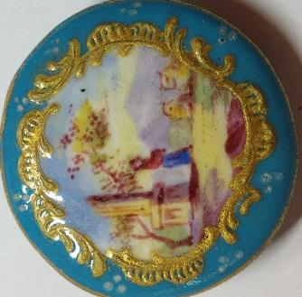
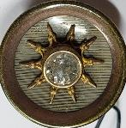
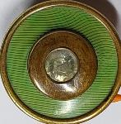
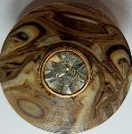
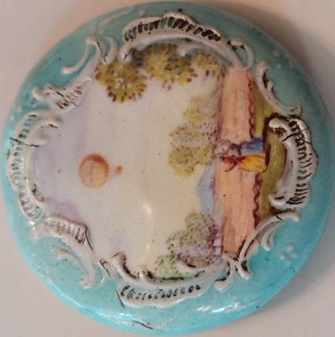
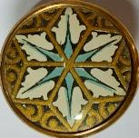
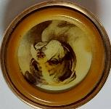
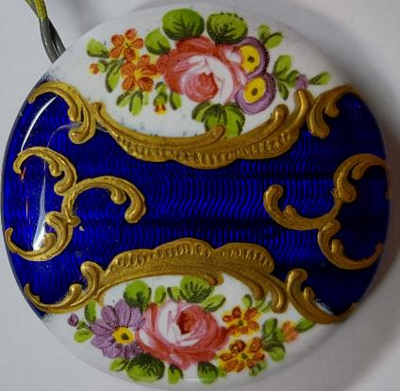
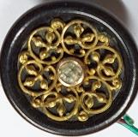
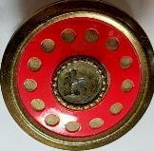
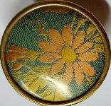
England
18th century Battersea enamels
19th century Birmingham Trade
Notes:
“England. The English made all kinds of buttons. This first group are what collector’s call Battersea or Bristol enamels, depending where they were made. They represent some of the finest painted enamels. The art of émaux peints, painting with enamels, was mastered in France and spread to England in the 1700s.”
Advance.
“These are from the 19th century and are called Birmingham Trade buttons. Birmingham was a great center for button production in the 19th and early 20th centuries. While these buttons are not backmarked with a maker’s mark, and there is no absolute way of knowing that they were in fact made in the Birmingham factories, they share common construction traits that make this a high probability. Hence their name. They are all small and were typically worn on a gentleman’s waistcoat. Here you can see some embellished with paste, celluloid, and fabric.”
Advance.

Slide 7
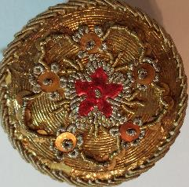
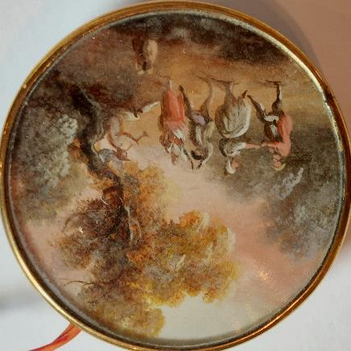
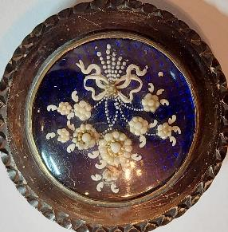
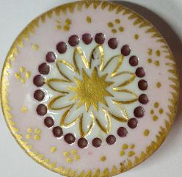
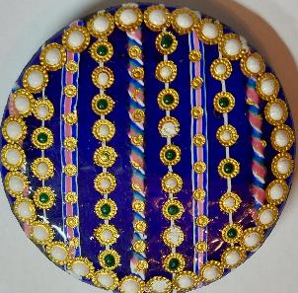
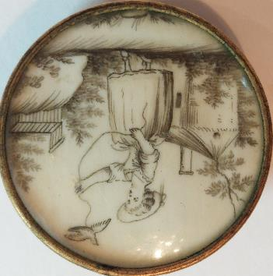
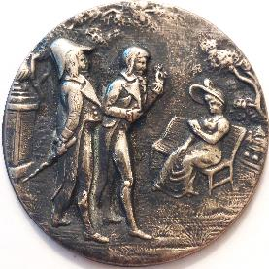
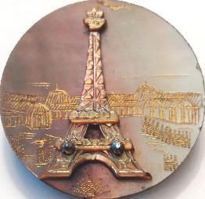
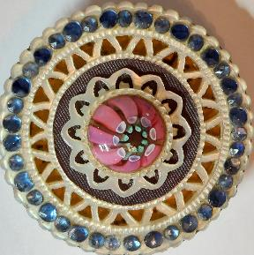
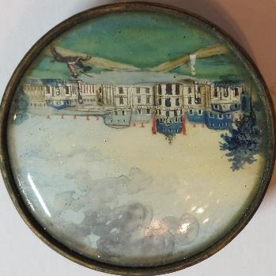
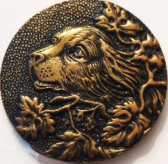
France
19th century French shell and metals
18th century
Notes:
For a bit of drama, the 18th century buttons appear one at a time with each advance. Give each button a few seconds before advancing.
“There is no way to overstate the contribution France made in elevating the button from craft to fine art, most notably in 18th century Paris. The French advanced and invented decorative techniques for buttons. This group of old buttons represent a variety of materials and techniques.
This large button is a paining of great detail under glass, possibly on vellum, set under glass in metal. Advance. Here’s an exquisite monochromatic painting on ivory button. Note the subject matter of this button. In the 1700s in France, bird-catching was a metaphor for the pursuit of love. Images of women playing with captive birds were emblematic of the total submission of lovers to their mistresses. The expression “being tied down” is still used today to describe a romantic relationship in which one person is so smitten with the other that they are at their mercy. Advance. This is copper under glass with a blue enamel center, on which are tiny pearls set for the flower heads and white paint for the bow and stems. Advance.
This button is enamel with protrusions and tiny shapes of precision cut gold foil, called paillons.” Advance. This button is made of pierced and carved mother-of-pearl with a glass center “jewel” and border of blue pastes. Advance. Next is a passementerie button that illustrates the French expertise working with metal thread and foils. Advance. This is a porcelain button with gilt. Finally, this is another finely detailed painting on ivory.
Advance.
“France continued to make wonderful buttons in the 19th and 20th centuries even though no longer hand wrought.” Advance.

Slide 8
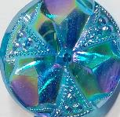
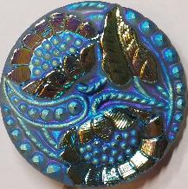
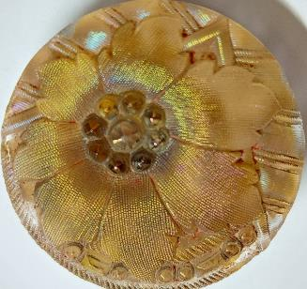
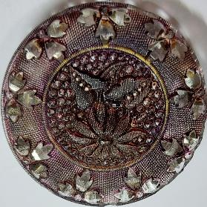
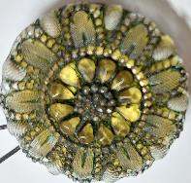
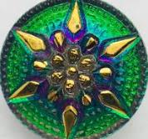
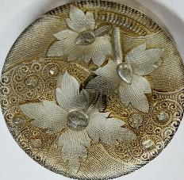
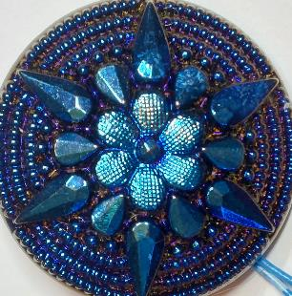
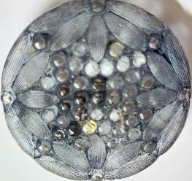
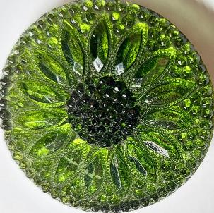
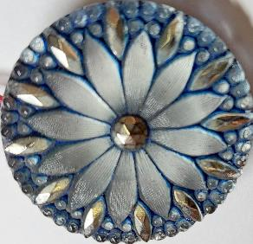
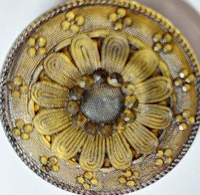
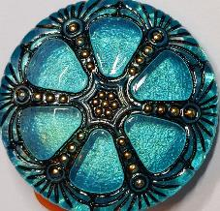
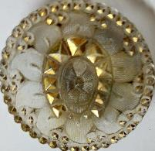
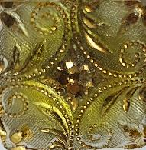
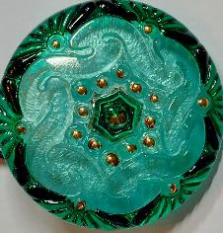
Czechoslovakia
Currently Czech Republic
Antique Czech glass
20th century vintage Czech glass
19th century lacy glass
Notes:
“Czechoslovakia has been and still is known for their excellence in glass work. And the buttons they made are no exception. The buttons in this first group are antique buttons that collectors refer to as lacy glass. They are usually made of clear glass with a finely stippled surface design. The backs are painted with color or silver or gold, and then covered with black paint.”
Advance.
“Compare them to their more contemporary counterparts. These vintage buttons are from the 1990s.”
Advance.

Slide 9
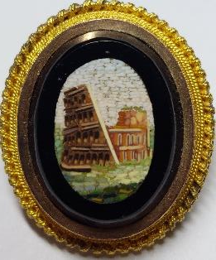
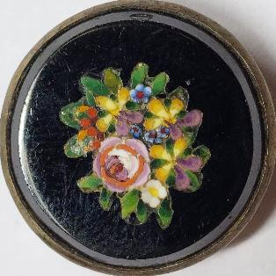
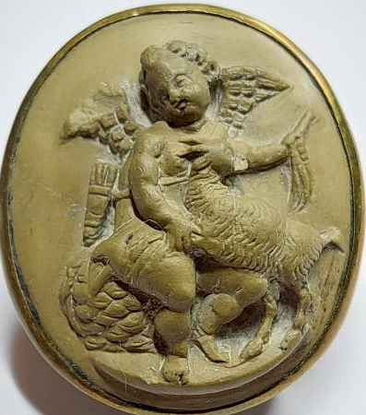
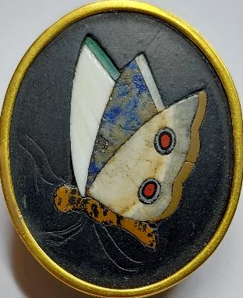
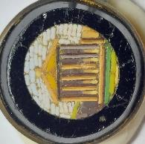
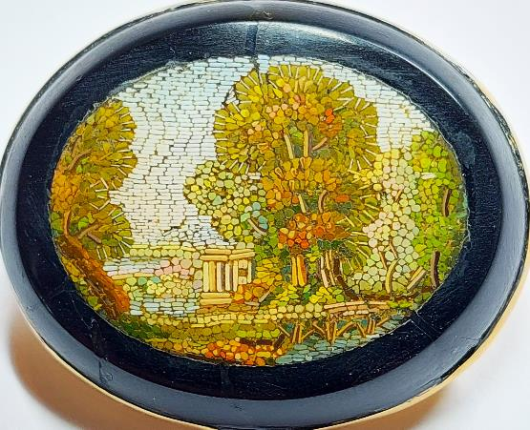

Italy
19th century micromosaic
19th century pietra dura
19th century lava cameo
Notes:
“Romans were making glass and enamel buttons for centuries. But in the 18th century to the middle of the19th century, a renewed interest in button making in Italy produced some wonderful expressions of the craft. This was an outgrowth of the Grand Tour—a virtual educational rite of passage for British young men of noble and wealthy means—of which Italy and a study of its classical antiquity were its key destination and purpose. Buttons were precious tokens and keepsakes of their journey and brought back as gifts for loved ones.
This group is a collection of micromosaics made from tiny glass tesserae. Mosaic work goes back to ancient history and reached its pinnacle in the Byzantine Empire. It wasn’t until the mid-1700s that craftsmen started experimenting with minute tesserae to create what are referred to now as micromosaics.” Advance.
“Cameo carving from lava stone was very popular in Italy in the 19th century. The lava from Mount Vesuvius that covered the ruins of Pompeii was a good material for carving cameos and intaglio and made great souvenirs for tourists.” Advance.
“The art of pietra dura, an Italian art form of inlaid colored and differently-shaped stones into a backing originated in ancient Rome, where it was used to decorate floors and walls. The technique featured both geometric and figurative designs. This is a 19th century example.” Advance.

Slide 10








Japan
19th century Shakudo
19th and 20th century gin bari
19th and 20th century Satsuma
Notes:
“Japan, like Italy, produced beautiful buttons largely as an outgrowth of western tourism in the 19th century. In 1868 Japan opened itself to Western influence and travel for the first time since the early 17th century. While traditional dress in Japan had little use for buttons, they recognized an opportunity in making them for Western tourists. Traditional Japanese arts hundreds, if not thousands of years old were applied to buttons.
As these examples will show, the results were beautiful. This first group shows the gin-bari enamel technique. Gin-bari buttons have great depth to them, created by the silver leaf backing. The silver is stamped, punched, or otherwise textured and reflects light through the enamel almost like a stained glass window.” Advance. “Shakudo is an alloy of copper with a small amount of gold. Its earliest known use was in the 12th century to decorate Samurai swords. The large button shows a popular Japanese adaptation of the Chinese Foo Dog, or Lion Dog. They were popular architectural elements often at the entrance to a home, palace, or other building that were thought to have protective powers. The second button has a shakudo element set on ivory.” Advance.
“Satsuma pottery was first made in the province of the same name back in the 16th century. These buttons reflect the look that evolved over time with a crackled glaze, and heavy gold stippling.”
Advance.

Slide 11











United States
Vintage Navajo
Vintage Pearl Button Cards
Notes:
In the years of the American colonies, most buttons were imported from England. But as the colonies grew, button manufacturing took hold from the early 1700s in New England. Most of these were of metal and utilitarian in nature. It was the 19th century that marked the real growth of button making in the United States, especially starting in 1855 with the manufacture of shell buttons. The Mississippi River supplied most of the shell, with Muscatine, Iowa at the heart of the industry, hailed the “Pearl Button Capital of the World”. A 1916 report on button trade in the US identifies fresh-water pearl buttons as the most important branch of the industry, representing 45.4% of the total output value. These early button cards are from the key factories at the time: Automatic Button Company (ABC and Blue Bonnet), Hawkeye Button Company (Mermaid), American Maid Button Company, Muscatine Pearl Works (Luckyday), and McKee Button Company. Advance.
The pearl button industry may have been a showcase for new manufacturing methods, but the buttons were hardly examples of American creativity. The opposite can be said of the native Navajo who are recognized for their beautiful work in silver and turquoise. Commercialization of their work began around the turn of the century, when the Fred Harvey Company ordered Navajo silverwork to sell to tourists. By 1878, several dining/hotel establishments named Harvey Houses ran along the Atchison, Topeka & Santa Fe Railway (AT&SF) in Kansas. Harvey and his company became leaders in promoting tourism in the American Southwest in the late 19th century, promoting the region by creating the "Indian curio" shop. These buttons are vintage, from the early 20th century, and illustrate some chiseled and punched designs common to their work.
Advance.

Slide 12

Buttons teach us history
Social and cultural
Political
Art
Fashion
Notes:
“One trait that buttons from all cultures have in common is their ability to teach us history. Buttons are history you can hold in the palm of your hand.
We get a glimpse into both social and fashion history by way of this 18th century etching. Cut-steel accessories were the rage in the 1700s, given steel’s ability to replicate the sparkling effects of cut diamonds and precious metals. Cut-steel provided a way to get around sumptuary laws of the time and make a bit of bling accessible to the less wealthy.
The French fashion for eye-catching buttons grew and they became increasingly large and dazzling. This trend became the subject of satirists—as illustrated by this 1777 print entitled ‘Coup de Bouton’, which shows a dashing young gentleman’s buttons blinding a young lady passing by. Was she impressed?”
Steel buttons: Coup de Bouton, etching by William Humphrey, c. 1777. Lewis Walpole Library, Yale University.
Advance.

Slide 13




Social and cultural history
Courtship and love
Notes:
“One can say that the French turned love into an art and these buttons from the 18th century illustrate this sentiment. The large button is painting on ivory probably commemorating the couple’s wedding. It’s signed CF and dated 1697 on the pedestal, but the button is believed to be c.1770-1780.
The other three are rebus buttons. Rebuses were used as discreet declarations of love and when worn they could convey an initial attraction or publicize a match.
Painted under glass, Elle a gagné ce mon coeur. Or, She has won my heart.
Below that, a carved mother-of-pearl, Elle a cédé. Or, She has given in.
The third, Musique de mon coeur. Or, music to (of?) my heart.”
Advance.

Slide 14





Social and cultural history
Loss and grieving
Notes:
“In the past as well as today, memorializing lost loved ones was often done through personal adornment. But unique to the past, are buttons that were created and worn for the time of mourning. The three buttons on the left are from the 18th century and depict common visual themes for mourning buttons.
On the left is a silvered copper etched with an urn. The button to the right is also copper with painted ivory under glass of woman at an urn on a pedestal, and the third is a shell under glass with hair and painted leaves to form a wreath and bouquet.
The two brass 19th century buttons also include hair woven in a basket pattern.
Queen Victoria’s long and very public grief over Prince Albert’s death in 1861
launched the manufacture and widespread use of black glass buttons (imitating the Queen’s jet).”
Advance.

Slide 15









Social and cultural history
Status and wealth
Notes:
“All fine buttons in the 18th and 19th century were worn as a symbol of wealth irregardless of their decoration, as only the wealthy could afford them. But some buttons were distinctly created with this purpose in mind.
These buttons are from the 19th century. Collectors refer to them as Jewels. The blue button is enamel and the others are glass. All have paste, or strass, borders.
These are livery buttons from the 19th century. Liveries, or uniforms, were worn by servants of the very wealthy to publicly display their status and family affiliation. They depict heralds, crests, badges, and monograms.”
Advance.

Slide 16









Social and cultural history
Sporting
Notes:
“Sporting buttons were worn on jackets and coats, often in sets of various design like the engraved mother-of-pearl set on the right. (These are actually all the same size.) The brass buttons on the left aren’t “sporting buttons” as defined by the NBS because they weren’t worn on hunt coats. But they do portray sporting and have wonderful detail Note the women riding sidesaddle and the fallen horse and rider. All are from the 19th century.”
Advance.

Slide 17









Political history
United States
Notes:
“Political associations on buttons could be overt or subtle. This copper button is the most revered American button. It commemorates our first president with each of the 13 colonies artfully linked as the button’s border. This is one of an extremely rare set of what is thought to total 27 designs, that were issued to and worn by significant attendees of his inaugural ceremony. “GW” buttons, as they are known by collectors, set records when one happens to show up at auction.
When the Frent Collection of Political and Presidential Americana went up for auction in 2018, it produced the world’s most valuable Washington button with a high bid of $225,000. It featured a stamped bust of Washington and the words "Pater Patriæ," a Latin phrase meaning “Father of his Country.” Advance.
These are called Jacksonians. They are always small, one-piece gilt buttons with separate rims. Most are pictorial. They get their name from the era when they were popular, 1820s-1830s when Andrew Jackson was president. They are not political per se, but are of a particular political period. Advance.
Here is a liberty button. These buttons were indistinguishable from the standard issue military uniform buttons allowing a solider to pass inspection while holding two pictures of loved ones close to his heart. Advance.
Made by the Liberty Manufacturing Company in Los Angeles, they sold for 75 cents. Advance.

Slide 18





Political history
French revolution
1789-1799
Notes:
“Buttons from the French Revolution and those made a century later to commemorate it are favorites for some collectors. The scene on the large buttons is hand painted on paper and under glass, showing the storming of the Bastille on July 14, 1789. At the top of the scene is a banner saying "le Despotisme abatu" (despotism demolished).
The small metal button to its upper right is a military button from the revolution. Both are 18th century.
The others are 19th century reproductions of 18th century buttons made to commemorate the centennial of the French Revolution.”
Advance.

Slide 19

Fashion design history
Women’s stomacher, 1760-1780, Italy,
V&A Museum
Notes:
“Throughout their history, buttons, most fundamentally, were used either as surface adornment or to secure garments. It’s extremely rare to find one still attached to its original garment. Mostly we find the less valuable cloth covered or thread woven variety. Buttons were essentially the same as jewelry, and removed from a garment no longer worn or given away so that they could adorn a new one.
Seeing a button preserved in its original context breathes life into the button itself. The degree to which they were meticulously crafted to complement a specific textile is remarkable.
This slide shows passementerie buttons on a stomacher. These would not have been functional, but decorative. The stomacher would have been laced onto the body.”
Advance.

Slide 20

Fashion design history
Men’s court coat and waistcoat, 1800, England, V&A Museum
Notes:
“These embroidered buttons on the coat and waistcoat complement the ensemble perfectly.”
Advance.

Slide 21

Fashion design history
Women’s riding coat,
1750, English, V&A Museum
Notes:
“It would be unthinkable today to ride in such an exquisite riding habit as this. But it must have been quite an elegant sight going over a fence in pursuit of the game. These buttons appear to be gilt metal wound with gold thread. Or they may be like the first, of passementerie with gold thread and sequins to match the detail on the coat.”
Advance.

Slide 22

Fashion design history
Men’s coat,
1800, French,
V&A Museum
Notes:
“These buttons appear to be steel with cut steels around a center mother-of-pearl.”
Advance.

Slide 23

Fashion design history
Evening Jacket,
Jeanne Lanvin, 1936, Paris,
V&A Museum
Notes:
“As the ages progressed, buttons lost their significance as other displays of status replaced them. In more modern times, the couture houses in Paris took care in choosing a button for its fashions. But the days of wearing art on your bodice or sleeve were over.”
Advance.

Slide 24

Fashion design history
Elsa Schiaparelli, Evening Jacket,
1937, Paris, Musée des Arts Décoratifs
Notes:
“The couturière Elsa Schiaparelli (1890-1973) was a key figure in Paris fashion between the two World Wars. Acknowledged by her contemporaries as the style arbiter of the 1930s, Schiaparelli’s creations mirrored the social, political, and cultural climate of her times. She drew much of her inspiration from her close ties to the Parisian avant-garde of the 1920s and 1930s. In 1935, the Maison Schiaparelli opened in the Place Vendôme in Paris, selling collections designed for sports, city and evening wear.
This jacket was made at essentially the same time as the previous jacket by Lanvin, but the ever-daring and visionary Elsa transformed the buttons on her jacket into artistry that may have veered toward the political. The butterflies, in themselves symbolic, colored blue, white, and red may have referenced hope despite the turbulence in France at the time– after the devastation of WWI and ensuing depression and facing the ever-growing fear of Hitler’s Nazi regime.
Advance.

Slide 25





Art History
Rococo 1740-1770
Antoine Watteau, Pilgrimage to Cythera, 1718-1719, Charlottenburg Palace, Berlin
Notes:
“Buttons also reflect the art movements of their time. Louis XIV prefered stately and reserved classicism during his reign while the rest of Europe’s art and architecture evolved into the lavish and dramatic baroque style. After his death, France seemed to celebrate and the Rococo period was born. Rococo is the age of Watteau, Fragonard, and Boucher. Their colorful and gay scenes were full of elegance, ornament, pastels and movement. Advance.
These buttons show the influence the rococo period had on buttons.
The large button in 18th century featuring the hairstyle that Marie Antoinette and her court made so popular. It’s ink with wash on paper under glass.
The button at the left is enamel in the en grisaille method of a cherub with a heavily gilded border. The other two are porcelain, painted of 18th century style lovers.”
Background painting: Antoine Watteau, Pilgrimage to Cythera, c. 1718–1719. Charlottenburg Palace, Berlin.
Advance.

Slide 26




Art History
Neoclassical period1750-1850
Diana and Cupid, Pompeo Batoni, 1761, Metropolitan Museum of Art.
Notes:
1750 and lasted until c. 1850. Neoclassicism began around the period of the rediscovery of Pompeii and spread all over Europe as a generation of art students returned to their countries from the Grand Tour in Italy with rediscovered Greco-Roman ideals.
“The rediscovery and new archeological finds of Pompeii in the 18th century, not only ushered in modern archeology but the Neoclassicism period in architecture and art. The arts were greatly fueled by Johann Winckelmann, the first modern historian of art, who published Thoughts on the Imitation of Greek Art in Painting and Sculpture in 1755. Winckelmann declared Greek art as the most perfect from the hands of man. Advance.
The renewed interest in Greek art was applied to buttons throughout the 18th and 19th century period. Here we have two 18th century buttons. The first is the Wedgewood jasperware set in steel. The button on the far right is a painting of Clio, one of Zeus’s daughters on silk under glass.
The head of Zeus is a 19th century transfer on porcelain, a type of button collectors call a Liverpool Transfer. They got this name not because they were necessarily made there, but because John Sadler and Guy Green of Liverpool claimed in 1756 to have invented transfer printing. Transfers were used to decorate pottery made by several Liverpool factories.”
Background painting: Diana and Cupid, Pompeo Batoni, 1761, Metropolitan Museum of Art.
Advance.

Slide 27






Art History
Gothic revival 1840-1940
Background painting: NEED TO SOURCE
Notes:
“Gothic Revival became a widespread movement in the first half of the 19th century, mostly in England. Admirers sought to revive medieval Gothic architecture, intending to complement or even supersede the neoclassical styles (previous slide) prevalent at the time. Its roots are intertwined with Catholicism and a re-awakening of Anglo-Catholic belief as a reaction to the growth of religious nonconformism. Advance.
The 19th century buttons shown here each reinterpret gothic motifs: the round stained glass windows known as rose windows, the knight in armor, heraldic devices, quatrefoils, and crockets (ornaments in the form of curved foliage used on gables and spires). Gargoyles, dwarfs, birds, oak leaves, and linenfold (carved ornaments representing folds of linen) are other common gothic motifs. Two are enamel and the others brass, two with cut steels.”
Background painting: NEED TO SOURCE
Advance.

Slide 28







Art History
Art Nouveau 1890-1910
Notes:
“Art Nouveau was a protest against industrialism and mechanization and their products. It set natural, undulating, and graceful forms against the ugly mass-produced objects. Its roots grew from the writing and philosophy of John Ruskin, and his pupil, William Morris, who led the Arts & Crafts movement in England.
It was an international style of art, architecture, and applied art--especially in the decorative arts. Forms borrowed from nature included vines, lilies, sinuous leaves and stems, butterflies, dragonflies, peacocks, swans, and water lilies. Women are its muse, depicted with long necks and flowing lush hair draped in gowns inspired by antiquity. They exude empowerment and sensuality. Advance.
The buttons here exemplify art nouveau. The three on the left are of brass, one with enamel, one with a large glass “jewel” and cut steels, and the third with metal openwork. The large button is hallmarked silver and the one to its upper right is brass. The last button is a metal openwork dragonfly with pastes.”
Background: Chrysanthemum, William Morris
Advance.

Slide 29












Art History
Art Deco
1919-1939
Modern Harlem Renaissance Revival art by Yori Design, 1980s
Notes:
“Art Deco first appeared in Paris in the 1910s and flourished in the United States and Europe during the 1920s to early 1930s. It has its origins in bold geometric forms of the Vienna Secession (an art movement started in Austria in 1897) and Cubism. From its outset, it was influenced by the bright colors of Fauvism and the exoticized styles of art from China, Japan, India, Persia, ancient Egypt, and Maya. During its heyday, Art Deco represented luxury, glamour, exuberance, and faith in social and technological progress. Advance.
In jewelry design, designers including René Lalique and Cartier started to introduce colorful gemstones, such as small emeralds, rubies and sapphires as well as featuring less-expensive materials. Most of these buttons are in plastic—celluloid and bakelite primarily. The small fabric flapper is a garter button.”
Background: Modern Harlem Renaissance Revival art by Yori Design, 1980s.
Advance.

Slide 30

Buttons depict every imaginable subject
Notes:
“The buttons you’ve seen barely scratch the surface of surface techniques and what can be found pictured on a button. The variety and richness of decoration are endless. The next few slides give a closer look at materials used to make buttons.”
Advance.

Slide 31











Material Close-up:
Celluloid
Glow Bubble
Ivoroid
Celluloid shield over lithograph
Wafers
Notes:
The development of celluloid started as an accidental discovery in 1855. In Birmingham England, Alexander Parkes found that the thick solution of nitrocellulose, alcohol and ether used in the early photographic process, turned into a solid after the solvents evaporated. He patented this discovery as a water sealer for fabrics. In the 1860s, an American, John Wesley Hyatt, acquired Parkes’s patent and with the help of his brother Isaiah, began experimenting with it. Eventually, in 1870, they were able to create a substance resembling a “horn-like material” and patented it the process calling its product celluloid.
Because of its capacity for imitating ivory, celluloid was soon used to make many items, buttons included. The buttons here illustrate several popular decorative techniques used with celluloid. The first is called ivoroid because of its ability to mimic carved ivory. Advance. Wafers are thin pieces of celluloid with surface decoration. Some are incised with fine designs, and some have colored or metallic paints, tints, and cut steels. Advance. Celluloid was often used as a shield to protect a lithograph print underneath. Advance. This early 20th century button is called a glow bubble. It has a hollow body with a translucent surface design that reveals foil underneath that gives it its glow.
Advance.

Slide 32






Material Close-up:
Pearl
Carved shell
Carved and pierced shell with enamel
Engraved shell with metal decoration with cut steels
Carved shell riveted to engraved and gilded shell base
Pearl mounted in metal
Applied transfer
Notes:
“Shell has been used to make buttons for centuries. You’ve seen simple, utilitarian buttons made in the U.S. The examples here demonstrate various techniques that have been used to make some exquisite pearl buttons. Carved pearls are wonderful—like shell cameos, they reveal different colored layers.
Advance. This button has an enameled ornament. Advance. And here is a simple background of pearl used to offset its mounting. Advance. Transfer designs were also applied to shell buttons.
Advance.

Slide 33










Material Close-up:
Plastic
Casien
Amino resin
Amino resin
Polyester
Bakelite
Notes:
“In the 20th century, plastic took many forms, including Bakelite, casein, acrylic, nylon, and polyester to name just a few. The potential of these synthetics was tremendous and the button industry embraced them to the fullest. They could be worked in a wide variety of techniques. Identifying the type of plastic used for a particular button, though, can be challenging. Here, buttons are labeled if their type of plastic is known.”
Advance.

Slide 34





















Materials
Celluloid
Ceramic
China
Enamel
Fabric
Black glass
Colored glass
Glass in metal
Horn
Metal
Shell
Plastic
Vegetable ivory
Wood
Bone
Ivory
Papier-maché
Notes:
“This slide gives an overview of how buttons are classified. The international standard for classification has been developed by the National Button Society and is detailed in its Blue Book. The Blue Book can be purchased on the Society’s website.
There are three button backsides pictured as well. Button backs and the type of shank can often help determine not only the base material of the button, but its age and if marked, where and by whom it was made.”
Advance.

Slide 35
















Techniques & Types
Hollow body glow bubble
Painted porcelain with 4-way back
Calico
Champlevé with openwork
Passementerie with pearl facia and thread back
Molded lacy-like with blue luster
Swirl back with brass impression inlay
Glass shield over en cliché
Impression inlay with pearl and metal
Cameo with glass eyes
Twinkle
Casein Brooks
Pierced, carved and dyed
Laminated
Repoussé with catgut and bone back
Carved
Painted
Notes:
“This slide identifies the techniques used on the buttons. This gives just a taste of all the button types and techniques used on them.”
Advance.

Slide 36

How to learn more
Refer to the NBS Blue Book and
Button Country
@ nationalbuttonsociety.org
Attend a local or national button show
@ nationalbuttonsociety.org/events
Notes:
“In closing, here are some tips for those of you that are interested in learning more or starting your own collection. The Blue Book is an essential resource.
Go to the NBS’s website under “event” to find a button event near you.
Advance.

Slide 37





How to learn more
Refer to the NBS Blue Book and
Button Country
@ nationalbuttonsociety.org
Attend a local or national button show
@ nationalbuttonsociety.org/events
Read a great book or two
Notes:
Pick up a great book about buttons. They’re loaded with pictures of buttons of all kinds.
Advance.

Slide 38




How to learn more
Refer to the NBS Blue Book and
Button Country
@ nationalbuttonsociety.org
Attend a local or national button show
@ nationalbuttonsociety.org/events
Read a great book or two
Check out an online auction
Notes:
Whether you want to buy buttons or just learn about them, auctions are another resource. These are three auction houses that offer monthly, quarterly or bi-annual quality buttons up for auction.
Advance.

Slide 39

How to learn more
Refer to the NBS Blue Book and
Button Country
@ nationalbuttonsociety.org
Attend a local or national button show
@ nationalbuttonsociety.org/events
Read a great book or two
Check out an online auction
Join a local button club
@ nationalbuttonsociety.org/connect
There are state and local clubs in most states.
Notes:
“And last, there’s nothing like the camaraderie of other button collectors. Local and regional button clubs are listed on the NBS website.”
Advance.

Slide 40

Buttons will surprise you!
Notes:
The end.

